Slide 1
Hospital Monitoring System
Ahmed salah tawfiK ibrahim
Federica dini

Slide 2
Temperature Monitoring System
Goal: Development of an IoT telemetry and control system to monitor the temperatures of the patients at a hospital and trigger an alarm when it is too high or too low.

Slide 3
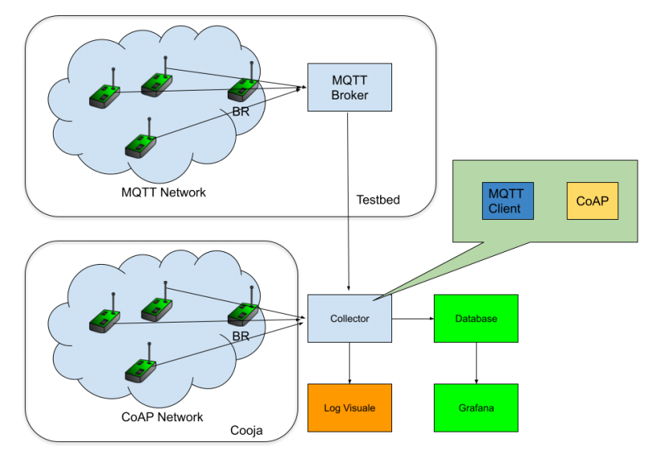
General Architecture
A simulated network (composed by 5 cooja motes) will exploit the CoAP protocol to report data. One of the motes will be the border router. It will allow the other motes to communicate with the external application.
A network composed by 4 real devices will exploit MQTT to report data. One of the nodes will be the border router. It will allow the other nodes to communicate with the application.
Data will be collected by a java collector that will use both MQTT and CoAP.
The collector will store data in a MySQL database.
A web-based user interface will show the data taken from the database in a useful manner through graphs.

Slide 4
The Collector
The collector is a java application developed using Californium and Paho thanks to maven.
It encapsulates a CoAP server with one resource called registry.
The registry has a get method and, when it is invoked, the server issues a get method to the CoAP well known core to get the resources associated with the server invoking the registry get request.
In addition, it has an observing CoAP client module that observes the temperatures.
Moreover, there is an MQTT client module that subscribes to the "temperature" topic on the MQTT broker. It publishes commands to the broker associated with the alarm topic of each specific sensor depending on the reported temperature value.
The Collector interacts with a MySQL database to store the reported temperatures.

Slide 5
The CoAP Network
Any node in the CoAP network exposes 2 resources, a thermometer and an alarm.
The thermometer is an observable resource and has only a get method associated with it for the purpose of observation.
The alarm is an actuator and so it has a post method to change its status.
The nodes periodically trigger a notification to update the collector with the current temperature.
The nodes periodically ping the collector to maintain/re-establish the connection by invoking a get request on the collector's registry resource.
This network interacts with the collector through the border router.

Slide 6
The MQTT Network
Any node in the MQTT network publishes to the topic "temperature".
In addition, all of them subscribe to the "alarm" topic associated with each one of them. It is constructed by adding the node ID to the word "alarm"
The nodes publish and get notifications about the topics through the MQTT Broker that they are connected to via the border router.
The broker is implemented using Mosquitto.

Slide 7
Error Handling
MQTT<-Broker->Collector
CoAP<-->Collector
The MQTT clients on the nodes and the collector will always try to connect to the Broker. In case they are connected, if the broker goes down, they will keep on trying to reconnect.
If the collector goes down, thanks to the periodic ping, the nodes will be able to issue a get request to the collector registry so the collector can register them again once it is rebooted by performing a discovery step.
If a node goes down, or gets isolated, the collector removes it from the registry. When it is back up, thanks to the registration step and the periodic ping, it will be added again to the registry.

Slide 8
Data Encoding
MQTT
CoAP
When the node publishes information about the temperature topic, it publishes the information in a JSON format because it allows adding different fields without making it difficult to parse on the collector's side.
When the collector publishes a command about the alarm topic, it is a plain text command because it is just one word (on or off).
When the node notifies the collector periodically, the message sent is a JSON message. This is because it is easy to add many fields, which is useful for our use case because we send the temperature along with other information, with understandable information and it is easy to parse in java using a library.
When the collector sends a post request to the alarm, it simply sends a plain text command because it consists of only one word (on or off).

Slide 9
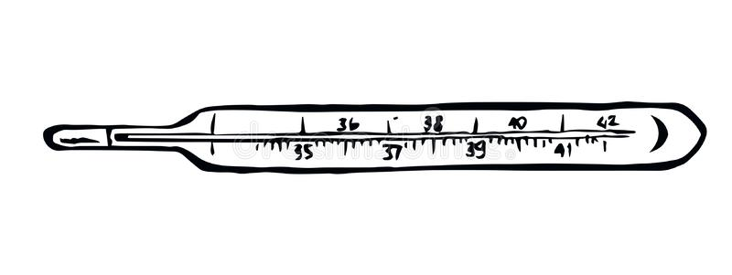

General Behaviour of the System
The nodes behave as thermometers (sensors), generating temperatures that is sent to the collector.
They also behave as red leds (actuators), that can be turned on/off by a command sent by the collector. We can imagine the red light as an alarm.
If any reported temperature is above 39° or below 36°, the alarm associated with the specific node is triggered through a command sent by the application.
When the temperature returns normal, the application sends to the node the command to turn off the red light.

Slide 10

General schema
CONNECTS TO
Web interface
TAKES DATA FROM
Database
user
SAVES DATA INTO
Collector
Observes temperatures Publishes alarm commands
Publishes temperatures Registers for alarm commands
node

Slide 11
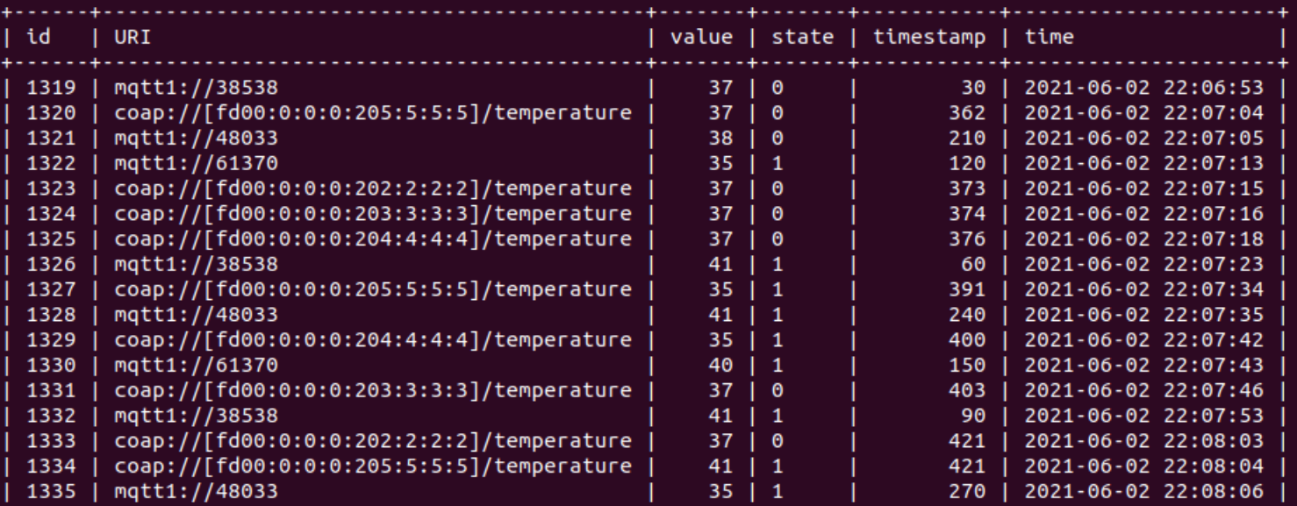
Structure of data
id = unique identifier for the measurement, integer that is incremented by the database
URI = string that can be used as a unique identifier for the node
value = temperature generated by the sensor (integer between 35 and 41)
state = binary that represents the state of the led of the node ( 1 = ON, 0 = OFF)
timestamp = integer that represents the moment in which the data has been generated
time = datetime value that is added by default by the database when the row is added

Slide 12
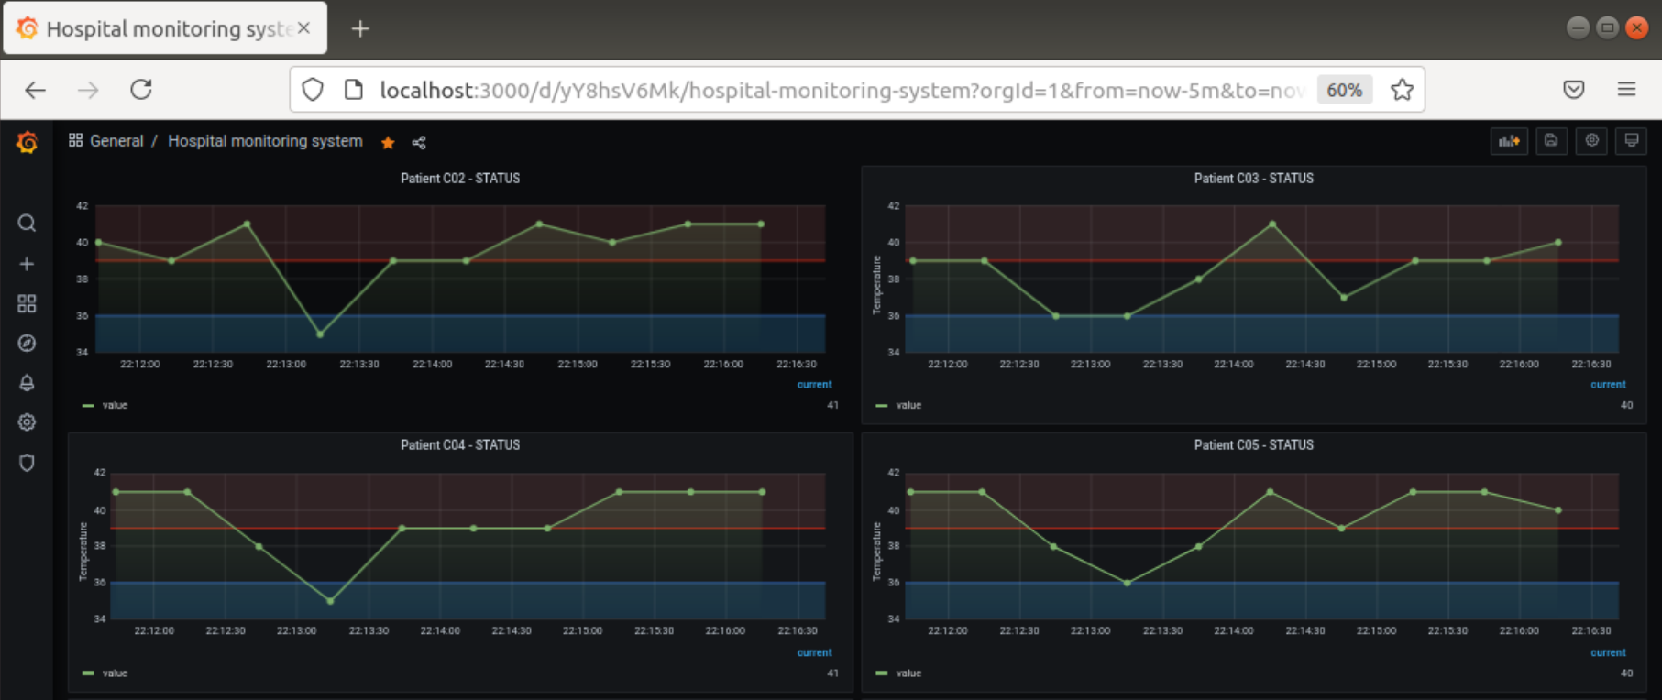
Web-based interface (Grafana)
Thanks to the web interface, a user can connect to «http://localhost:3000» to see the general situation of the patients of the hospital.
As we can see, for each patient a graph is displayed, showing his/her temperature during the last 5 minutes. It is possible to open each graph and to obtain more information.
Moving the mouse over the points is also possible to see the detailed information for each point.
The red area highlights the moments in which the temperature was higher than 39°, while the blue one underline the points in which the temperature was lower than 36°.
In the lowest part of the graph we can read the last value measured.

Slide 13
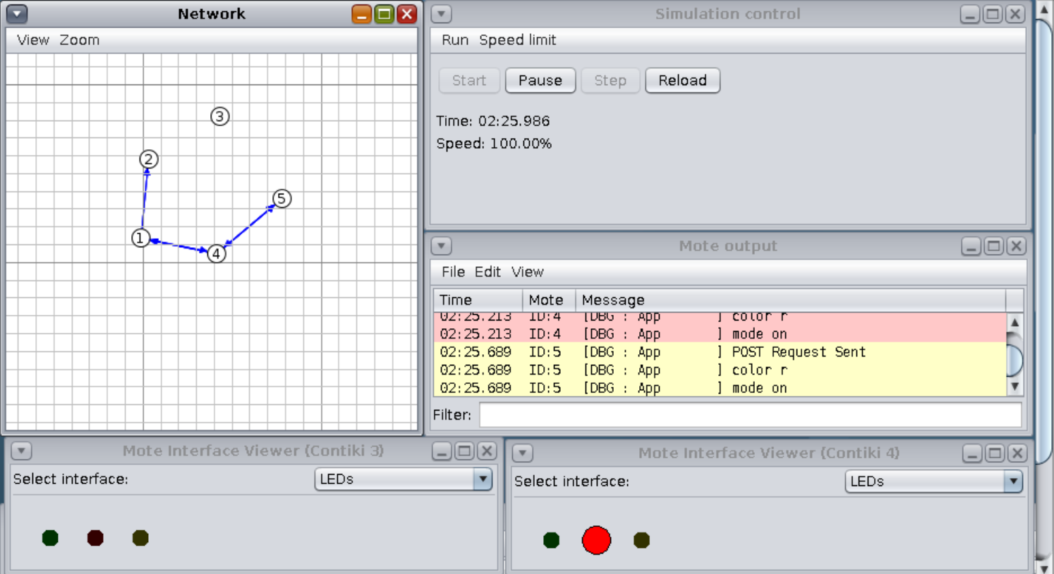
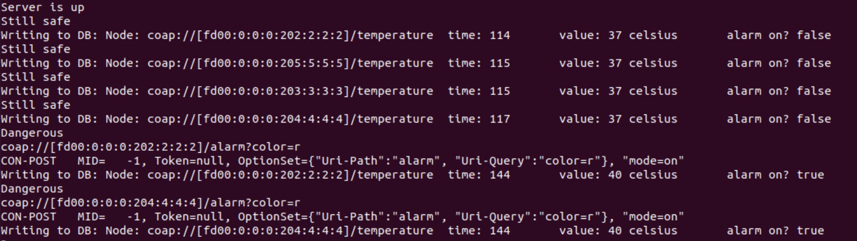
System in action
When the system runs, inside the Cooja simulator we can see the messages that are exchanged, and the color of the LEDs.
As we can see, the border router is not directly
reachable by all the sensors, so they have to find their neighbors and to
exploit the hop-to-hop communication.
Together with the user interface, some log messages are displayed by the application, so that it is possible to understand if the messages are correctly sent and received.

Slide 14
Thank you!
Any Questions??

